Slide 1
Python for Data Analysis Python Setup
YETI
Learn more at Afu.amazon.com
Amazon.com Confidential

Slide 2
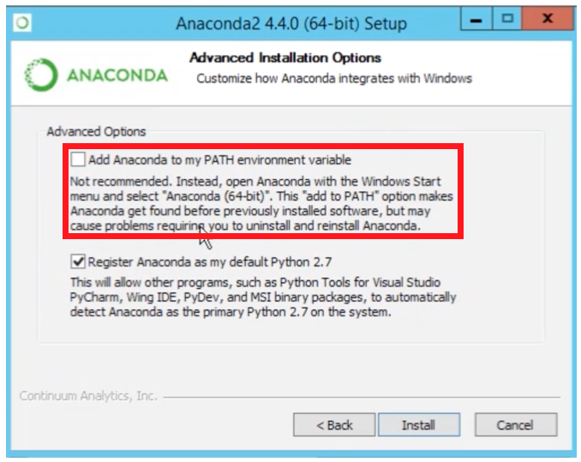
Python Setup (1)
Go to https://www.anaconda.com/download/
Choose your operating system (windows / macOS / linux)
Click green button to download Python 3.6 (not 2.7)
This should trigger a 600mb download
Once downloaded, follow default installation instructions, but ensure this (only on windows):
Unlike the picture to the right, make sure the checkbox is checked
Troubleshooting: see Anaconda_installation
Learn more at Afu.amazon.com
Amazon.com Confidential
Notes:
Hard stop at 20 minutes. All notebooks will also be provided on EIDER so that anyone can access without installing python on their computer

Slide 3

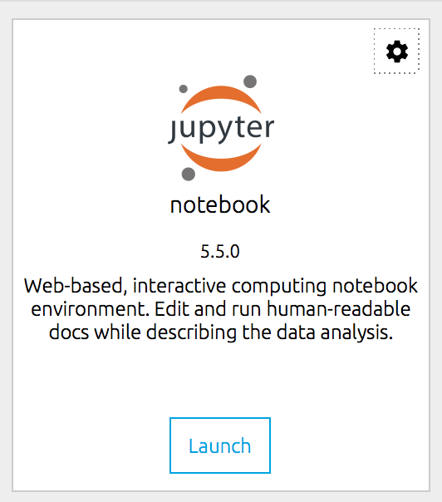
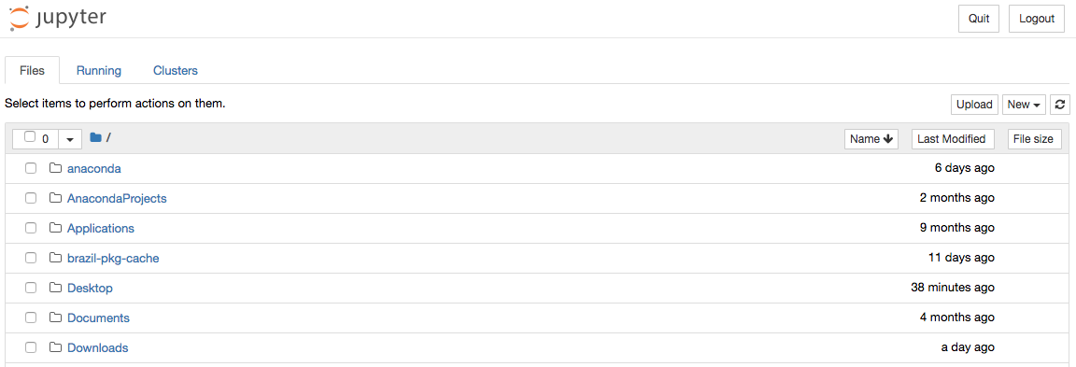
Python Setup (2)
After installation finishes:
Launch Anaconda Navigator
Click Home -> notebook -> Launch
OR go to command line and type “jupyter notebook” and hit enter
This should open a new web browser tab that looks similar to this:
Learn more at Afu.amazon.com
Amazon.com Confidential
Notes:
Hard stop at 20 minutes. All notebooks will also be provided on EIDER so that anyone can access without installing python on their computer

Slide 4
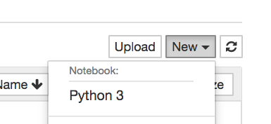
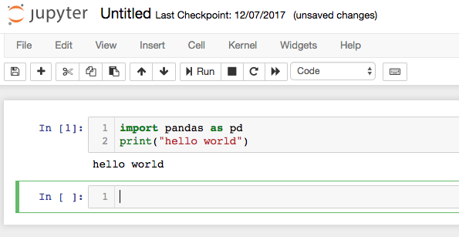
Python Setup (3)
Click New -> Python 3
This will open a new window. In the first box, type the following and press shift + enter to run the cell
import pandas as pd
print(‘hello world')
If you see “hello world” outputted below, everything has been successfully installed!
Learn more at Afu.amazon.com
Amazon.com Confidential
Notes:
Hard stop at 20 minutes. All notebooks will also be provided on EIDER so that anyone can access without installing python on their computer

